Slide 1
Eastern Region Umpires Seminar 2024

Slide 2
Agenda
Welcome
Rule changes 2024
Online Renewals Process
Event communications – why the radio might not always be best
Weighing coxes, lightweights and juniors
Scenarios for discussion/questions

Slide 3
Rule Changes 2024

Slide 4
Online Renewal Process (Dave Porter)

Slide 5
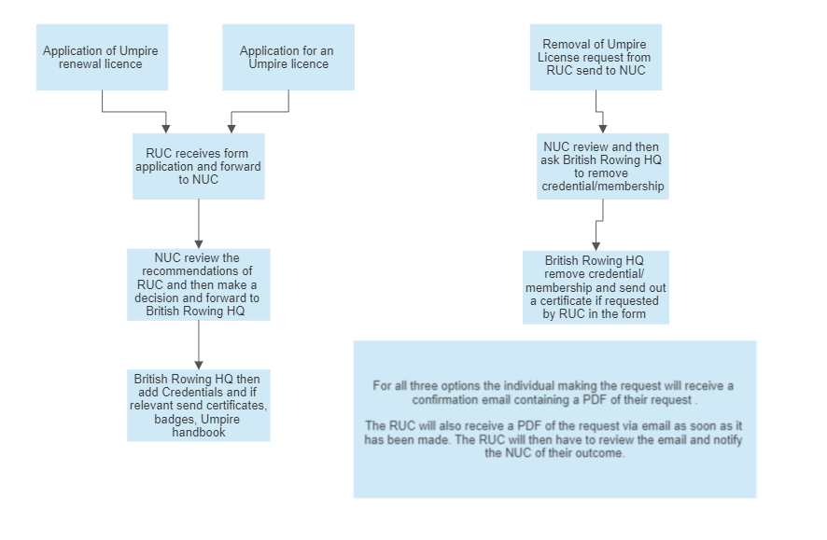

Slide 6
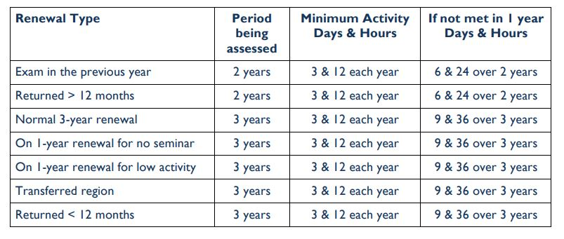

Slide 7
Notes
• Being a Race Committee Chair counts towards meeting the umpiring activity requirements but just being a member of a Race Committee does not count.
• Similarly launch driving, Race Control, Entries Secretary, commentary, timekeeping, Safety Adviser, Welfare Officer, RUC Rep., etc., do not count.
• Competitions that have been cancelled, for whatever reason, do not count towards meeting the activity requirement.
• There is no provision for an ‘exceptional’ or ‘conditional’ three-year renewal if the umpire does not meet the seminar requirement or the activity requirement.
• The umpire can appeal against a one-year renewal

Slide 8
Event Communications

Slide 9
Discussion
What methods of communication are available to us when Umpiring?

Slide 10
Pros and Cons of the radio
Pros
Easy to use
Quick and efficient
Everybody can hear (if they’re on the same channel)
Cons
Reliability
Privacy

Slide 11
Alternatives to the radio
Telephone call
Message/WhatsApp group
Face-to-face conversation

Slide 12
Communication – top tips
Consider if it is the most appropriate means of communication (e.g. emergency or forgotten lunch)
Remember, radios are easily overheard
WhatsApp groups can be excellent for disseminating information instantly and reducing impact of printed resources
Sometimes a face-to-face conversation is best

Slide 13
Weighing Coxes & Competitors

Slide 14
Discussion
How is your approach to conversations different when on Control Commission compared to the Start?

Slide 15
Discussion
How should we speak with athletes/juniors/coxes when weighing them in?

Slide 16
Impact of weighing coxes and competitors on health
What does the Science say?
Within the UK Sport “Eating Disorders in Sport: A guideline framework for practitioners working with high performance athletes”, lightweight rowing was identified as a “high risk” sport for the development of eating disorders. Evidence suggests an increased risk of disordered eating in competitive compared to non-competitive rowers (Kraus & Holtman, 2018); and in lightweight rowers compared to open weight rowers (Gapin et al., 2013). Furthermore, research suggests that up to 50% of rowers present with symptoms of disordered eating. Disordered eating is also linked to increased rates of injury and lower bone mineral density (Lundy et al., 2022).

Slide 17
What can we do to mitigate risk?
No subjective comments concerning the weight or body composition of any member should be made by anyone, and those conducting/present should always be sensitive to the feelings of athletes and how they may respond to any comments concerning their body.
When weighing takes place, it should be done in an area where no other individuals can see or hear the measurements except the person taking the measurements, with another appropriate adult present if the athlete is J18 and under.
For accuracy and consistency, the same scales should be used every time for taking weight measurements, as different models and makes can vary in their results.
Anyone registered to cox at a Competition or entering a weight-restricted category has to accept, before the entry is submitted to the Competition, that they are consenting to being weighed.
Lightweight rowers or coxes, at their request, can be weighed at a Competition without being told or shown their weight. This may be relevant to individuals who have or have experienced eating disorders and who do not wish to know their weight.
Anyone who is concerned that a rower or cox has an eating disorder should raise this as a safeguarding concern with the individual’s club, or with the Event Welfare Officer.

Slide 18
Scenarios

Slide 19
Discussion - what would you do?
A crew has not arrived for the start and it is 5 minutes until race time. You have called over the crews and announced the race. A crew sitting on the stakeboat are becoming agitated and ask you to find out what is going on and where their opposition are.
You are on Control Commission. A coach approaches you aggressively during an event and starts shouting at you about the race that has just taken place.
You are at an event and it’s 2.30pm. You appear to have been forgotten in the lunch distribution. How could you rectify this?
A cox arrives to be weighed and appears very uncomfortable, bordering on upset.
An junior athlete approaches you at an event and discloses that their coach has been acting aggressively towards them, shouting and swearing at them because they didn’t have a good row.

Slide 20
Thank you all for coming

